Slide 1
Family Carers:How do they do it?
How can we help?
Ghzala Ahmad

Slide 2
Challenges
National changes – Cut backs and major restructuring, new slants on major acts and laws.
Societal changes – New communities settling, new family and relationship structures, technology aiding and hindering socialising etc.
Personal factors – Attitudes about personal wellbeing and rights, health and resources.

Slide 3
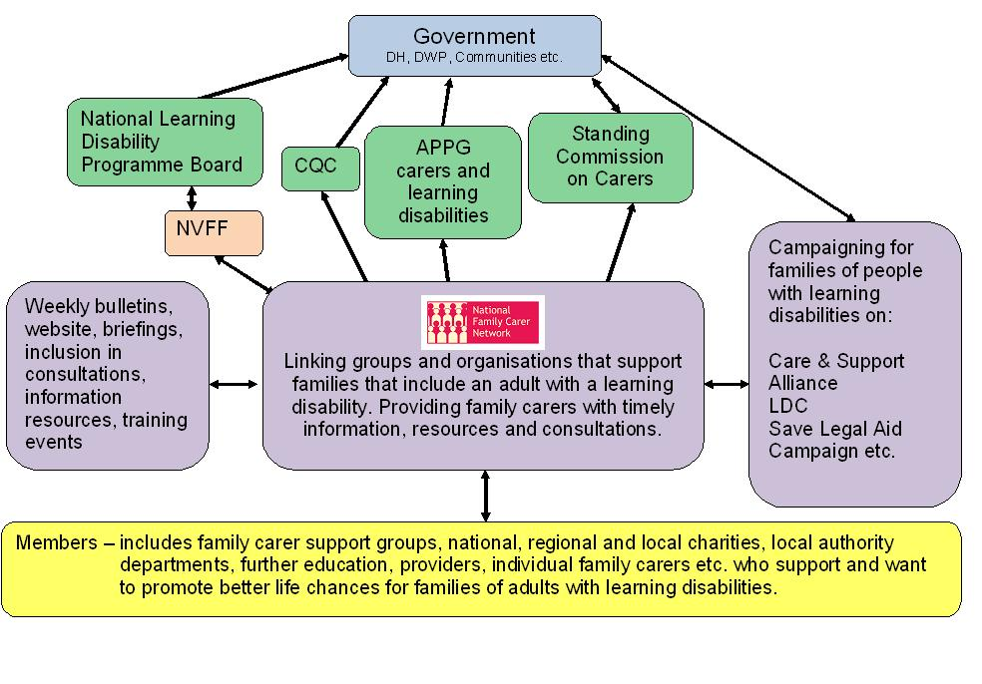
 |  | How the National Family Carer Network facilitates the voice of family carers of adults with learning disabilities
Please see notes below for explanation for the abbreviations.
Explanatory Notes APPG – All Party Parliamentary Group - An all-party parliamentary group^{[1]} (APPG) is a grouping in the UK parliament that is composed of politicians from all political parties CQC – Care Quality Commission – The Care Quality Commission is the independent regulator of all health and social care services in England. They check whether hospitals and care services are meeting national standards. They are funded through a combination of registration fee income and Government grant-in-aid. HealthWatch England will be a statutory committee of the Care Quality Commission (CQC) with a Chair who will be a non-executive director of the CQC. LDC – Learning Disability Coalition – The LDC was originally formed with a membership of 14 organisations to campaign for better social care funding. It is now being hosted by VODG (Voluntary Organisations Disability Group) National Learning Disability Programme Board – The National Learning Disability Programme Board was set up in 2009 when the Government published Valuing People Now. This replaced the Learning Disability Taskforce established through Valuing People in 2001. It is made up of senior Government officials from many departments, people from key organisations in the field, family carer representatives (from the National Valuing Families Forum), self advocates (the two Chairs of the National Forum for People with Learning Difficulties) NVFF – National Valuing Families Forum - The National Valuing Families Forum is hosted by Carers Trust. It developed through the Valuing People programme leads for families, who drew together representatives from family carers from nine regions across the country. This group helps the National Learning Disability Programme Board know what is important for families. It also provides direct links between family members who sit on local Learning Disability Partnership Boards and the National Learning Disability Programme Board. Standing Commission on Carers - The Standing Commission was set up to provide independent expert advice to Ministers and Government Departments. Since the National Carers Strategy – ‘Carers at the heart of 21st century families and communities’ - was published in 2008, the Commission's role is to advise on how the Carers Strategy is being put into action and to help shape further relevant policy development. Several members have a relative with learning disabilities and two are Advisers to the NFCN.
provided by WebEnable

Slide 4
The Family carer
Family circumstances come to a point where an issue or problem is becoming or is greater than the resources of the family to deal with it. (family identifies or external recognition)
Identifying what support is there.
Accessing support- criteria restrictions

Slide 5
Identifying – What Need?
Timely initial comprehensive assessment.
Multidisciplinary focus
Health
Social
Education

Slide 6
What’s out there?
Assumptions that any professional service or group would let you know of relevant services for your situations.
Awareness of learning disability (see II) and impact.
Visibility of services –(III) + religious venues, local /national events.
Need to be a source of knowledge of local services.

Slide 7
Can I get in?
FC : Do I fulfill the criteria?
Do I understand the criteria?
Knowing the purpose of the service, time frame, details.
Next steps

Slide 8
Rotating Door
Identifying- What need?
Can I get in?
What’s out there?

Slide 9
Good example
www.grapevinecovandwarks.org

